Slide 1
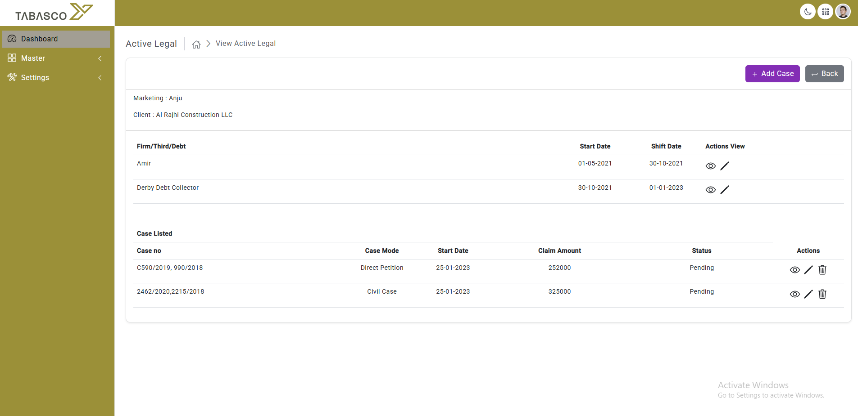

Slide 2

Add Roots
Date | Case Number | Category | Court | Stage | Last updation
 | 4050/1985 | Dispute
 | 2692/1985 | Commercial
 | 2184/1985 | Commercial appeal

Slide 3
Case no
Category
Lawyer
Regester day

Slide 4
Add Roots
Date | Case Number | Category | Court | Stage | Last updation
 | 4050/1985 | Dispute
 | 2692/1985 | Commercial
 | 2184/1985 | Commercial appeal

Slide 5
Action Report / Need sub Category

Slide 6
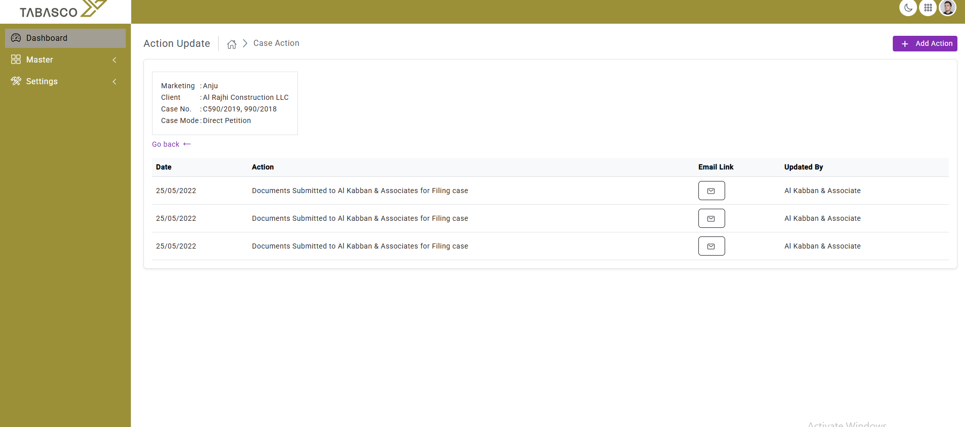
Add Sub cat / add Documents

Slide 7
